Slide 1
For Christmas
What would you like for Christmas ?

Slide 2
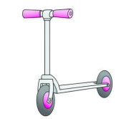
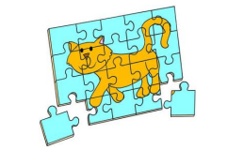
3
4
1
2
9
7
5
8
6
www.ardoise-craie.fr

Slide 3
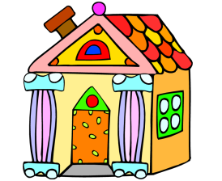
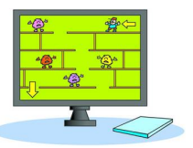
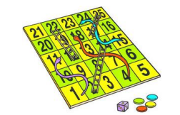
13
12
10
11
17
15
18
14
16
www.ardoise-craie.fr

Slide 4
3
2
4
5
6
1
8
7
9
11
12
10
17
13
15
16
14
18
www.ardoise-craie.fr

Slide 5
Vocabulary : Toys
cards
a teddy
a puzzle
a doll
a computer game
a robot
a skipping rope
a kite
a microphone
a bat and a ball
a paintbox
a playhouse
bricks
books
a football
a scooter
marbles
a boardgame
www.ardoise-craie.fr

Slide 6
www.ardoise-craie.fr

Slide 7
www.ardoise-craie.fr

Slide 8
For Christmas, I would like...
www.ardoise-craie.fr
What would you like for Christmas ?

Slide 9
For Christmas, I would like...
www.ardoise-craie.fr
What would you like for Christmas ?

