Slide 1
THERE IS / THERE ARE
www.ardoise-craie.fr

Slide 2
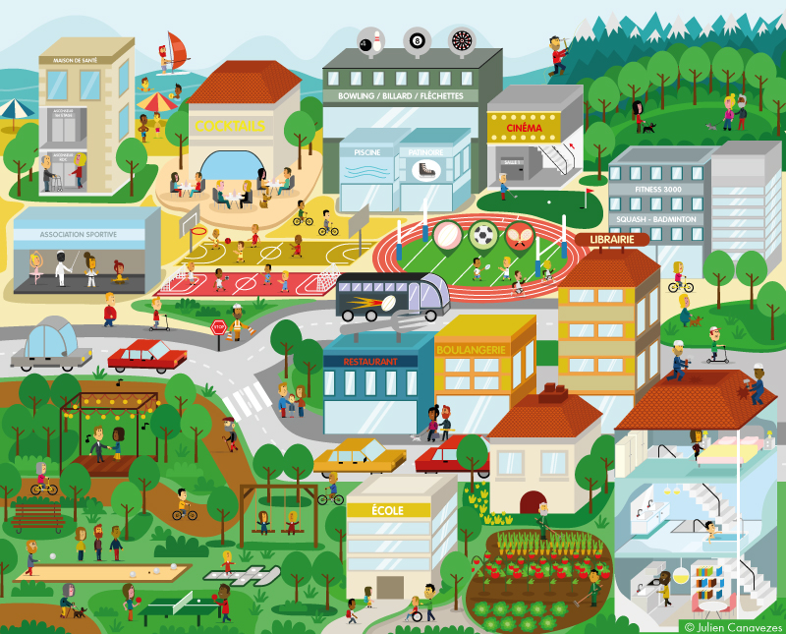
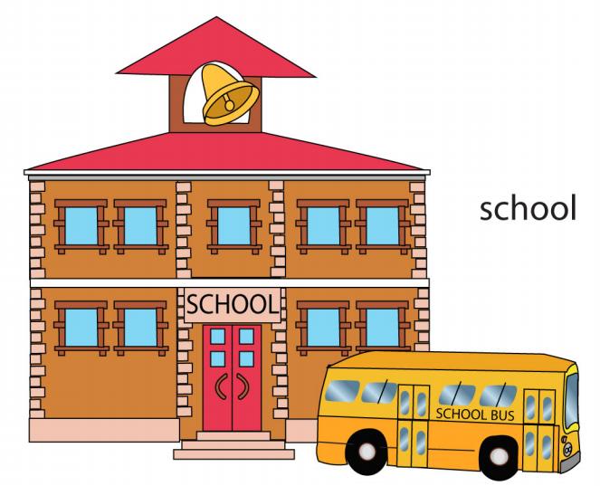
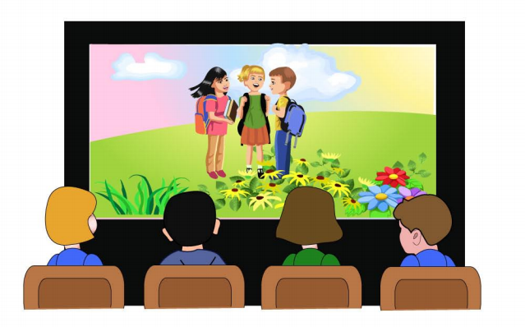
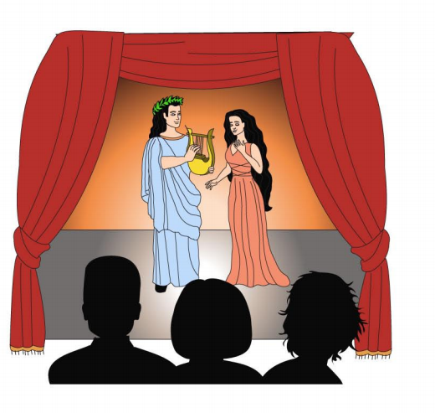
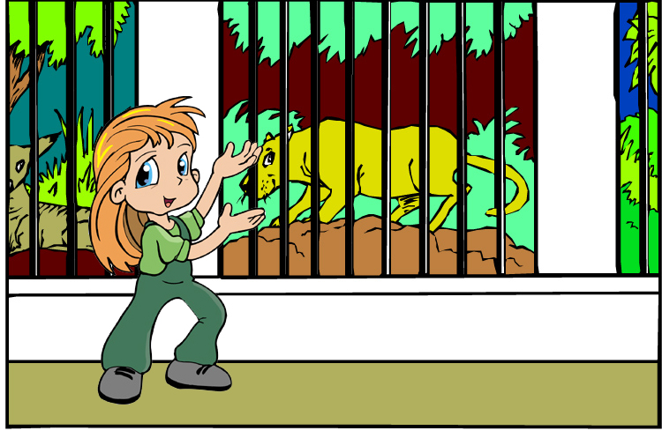
www.ardoise-craie.fr

Slide 3
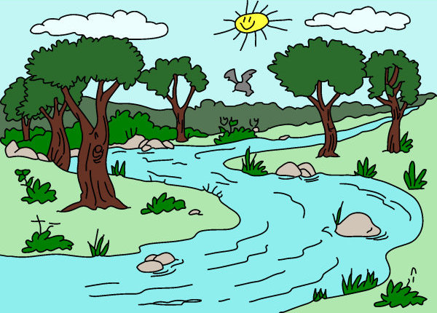
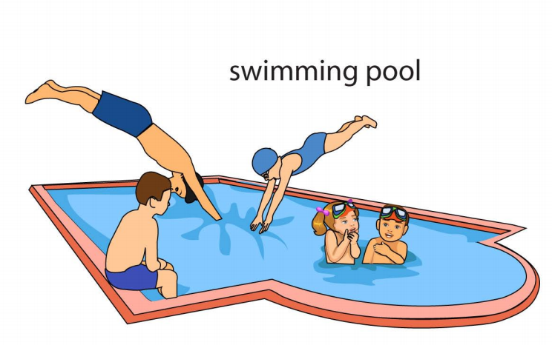
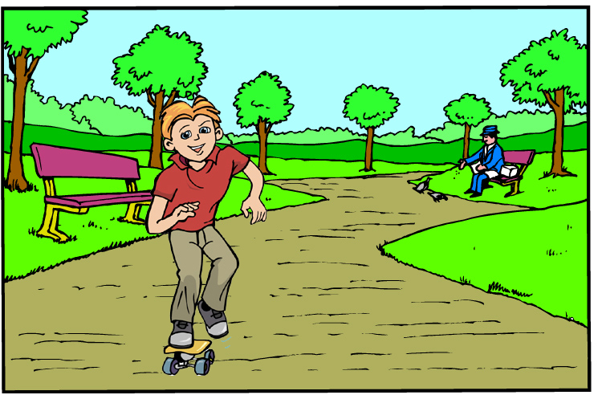
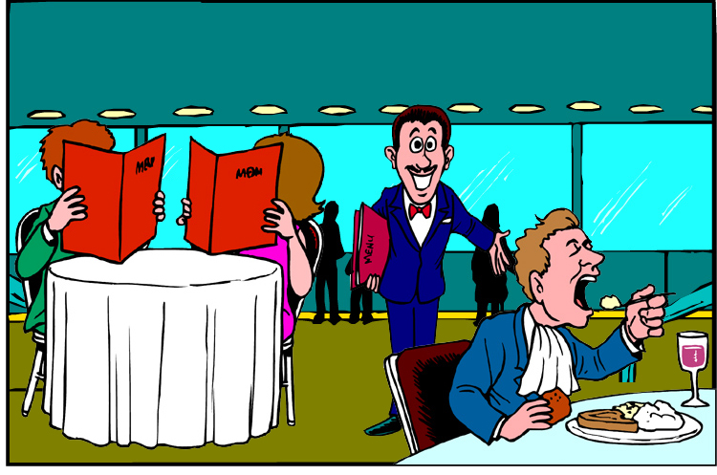
www.ardoise-craie.fr

Slide 4
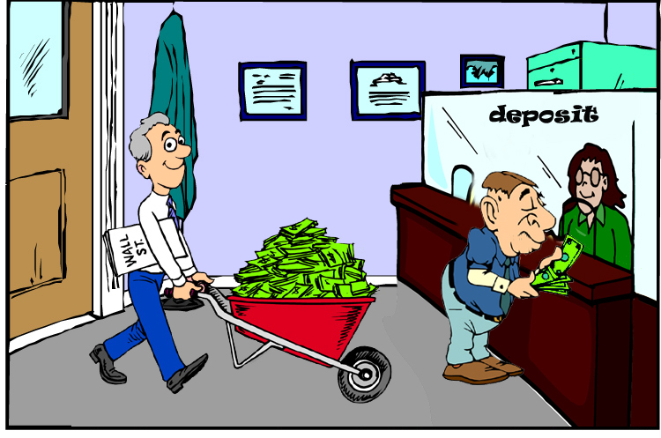
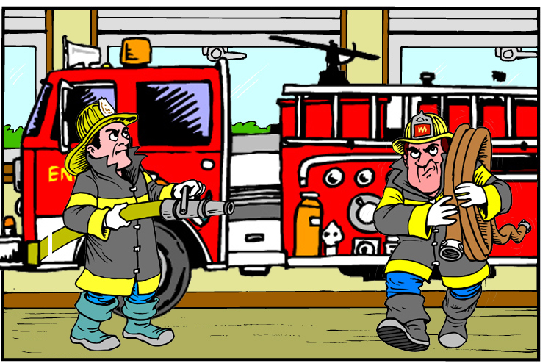
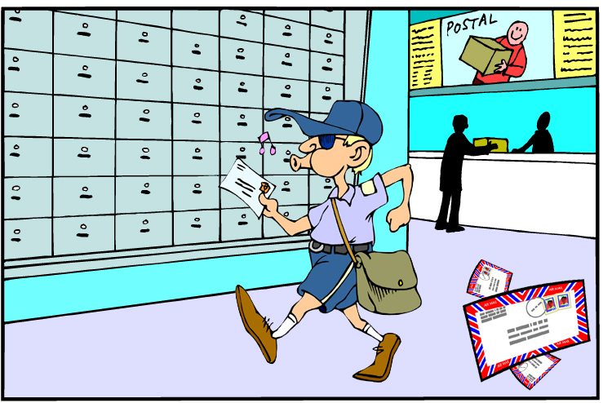
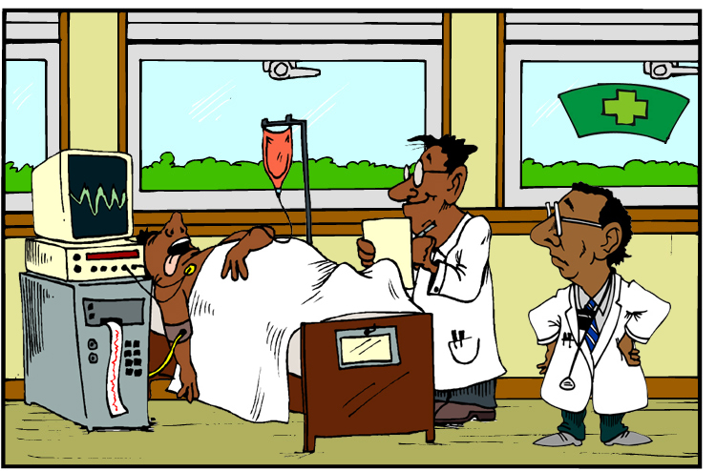
www.ardoise-craie.fr

Slide 5
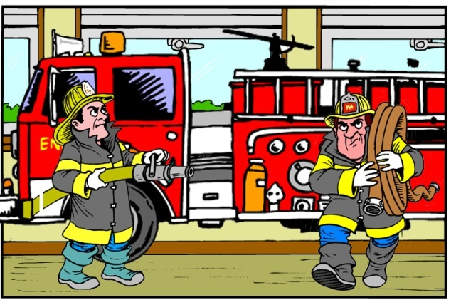
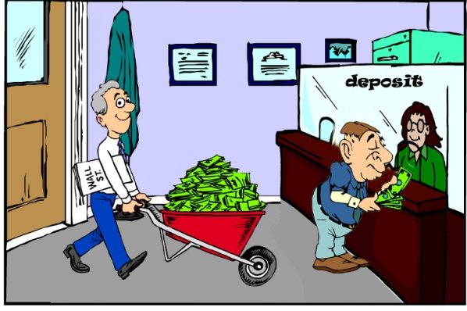
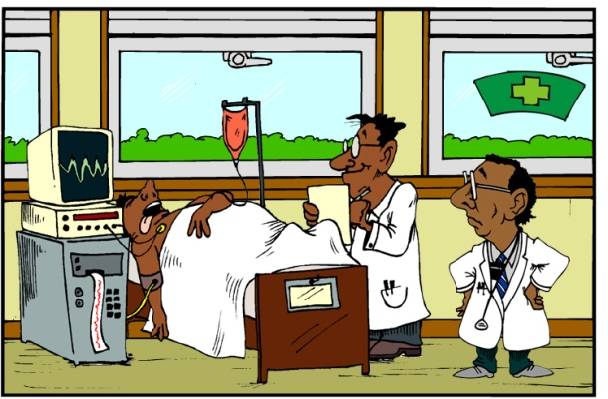
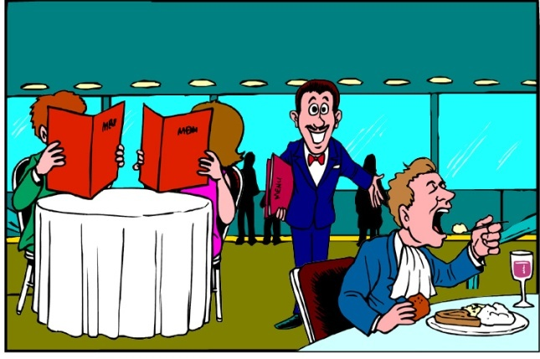
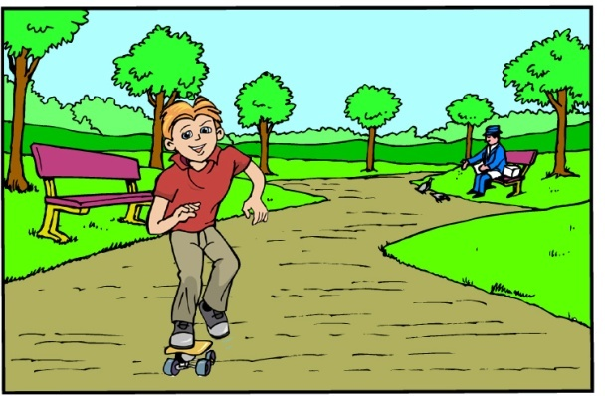
2
3
4
1
5
6
8
7
9
10
12
13
11
14
www.ardoise-craie.fr

Slide 6
Find the good word:
In my town, there ………………. a post office.
In my town, ……………..… is a bank.
In my town, ……………….. is a school.
In my town, there ……………..… a museum.
In my town, there ……………..… a canal bridge.
is
is
is
is
there
there
www.ardoise-craie.fr

Slide 7
Find the good verb:
In my town, there ……………..… a hospital.
In my town, there ……………..… a zoo.
In my town, ……………..… is a theatre.
In my town, there ……………..… a cinema.
In my town, ……………….. is a river.
there
there
there
is
is
is
is
www.ardoise-craie.fr

Slide 8
In my town, there is a…
www.ardoise-craie.fr

Slide 9
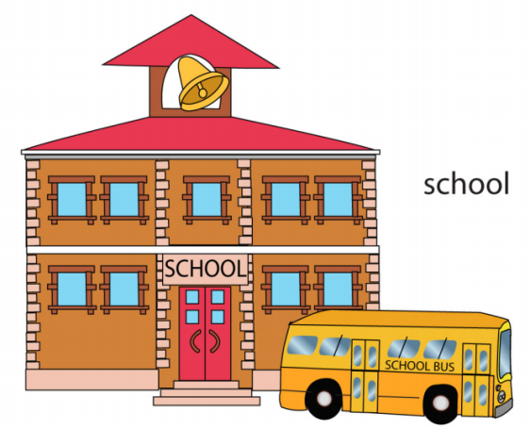
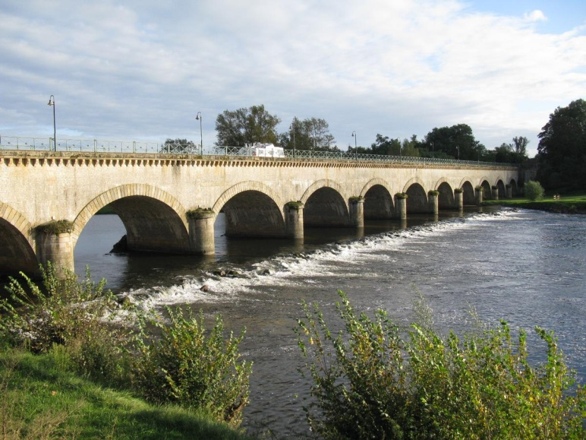
In my town, there are…

Slide 10
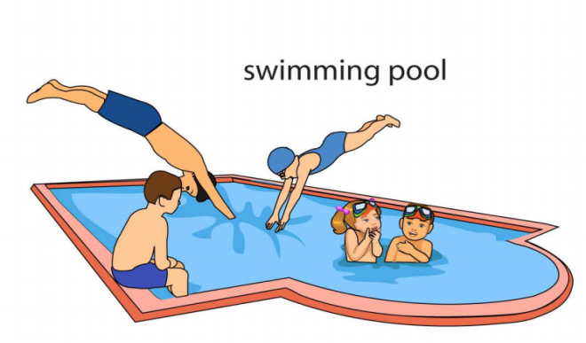
What is there in your town ?
www.ardoise-craie.fr

Slide 11
What is there in your town ?
www.ardoise-craie.fr

Slide 12
Find the good verb:
In my town, there ………………. a post office.
In my town, there ……………..… a bank.
In my town, there ……………..… four schools.
In my town, there ……………..… a museum.
In my town, there ……………..… three restaurants.
In my town, there ……………..… two hospitals.
In my town, there ……………..… a zoo.
In my town, there ……………..… two theatres.
In my town, there ……………..… a cinema.
are
is
are
is
is
are
are
is
is
are
are
www.ardoise-craie.fr

Slide 13
Find the good verb:
In my town, there ………………. a fire station.
In my town, there ……………..… a police station.
In my town, there ……………..… two cinemas.
In my town, there ……………..… a swimming pool.
In my town, there ……………..… two parks.
In my town, there ……………..… three schools.
In my town, there ……………..… a river.
In my town, there ……………..… four supermarket.
In my town, there ……………..… a post office.
are
is
are
is
is
are
are
is
is
are
are
www.ardoise-craie.fr

Slide 14
What is there in your town ?
www.ardoise-craie.fr

Slide 15
Find the good verb:
In my town, there ………………. a post office and two banks.
In my town, there ……………..… a bank and a school.
In my town, there ……………..… four schools and a hospital.
In my town, there ……………..… a museum and a cinema.
In my town, there ……………..… three restaurants and a police station.
In my town, there ……………..… two hospitals and a fire station.
In my town, there ……………..… a zoo and a river.
In my town, there ……………..… two theatres and a museum.
In my town, there ……………..… a cinema and a school.
are
is
are
is
is
are
are
is
is
are
are
www.ardoise-craie.fr

Slide 16
Put the words in the right order
town | in | there | is | my | a | post office
In my town, there is a post office.
there | town | my | in | are | restaurants | two
In my town, there are two restaurants.
is | a | there | zoo | my | town | in
In my town, there is a zoo.
are | town | there | in | schools | my | five
In my town, there are five schools.
canal bridge | in | there | my | is | town | a
In my town, there is a canal bridge.
www.ardoise-craie.fr

Slide 17
Put the words in the right order
town | in | there | river | my | a | is
In my town, there is a river.
there | fire station | my | in | is | a | town
In my town, there is a fire station.
is | a | there | bank | my | town | in
In my town, there is a bank.
are | town | two | in | there | museums | my
In my town, there are two museums.
hospital | in | there | my | is | town | a
In my town, there is a hospital.
www.ardoise-craie.fr

Slide 18
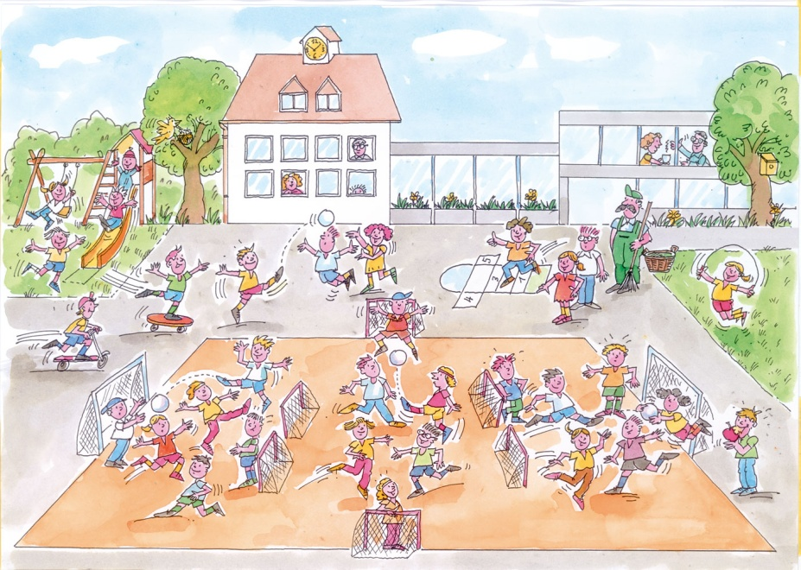
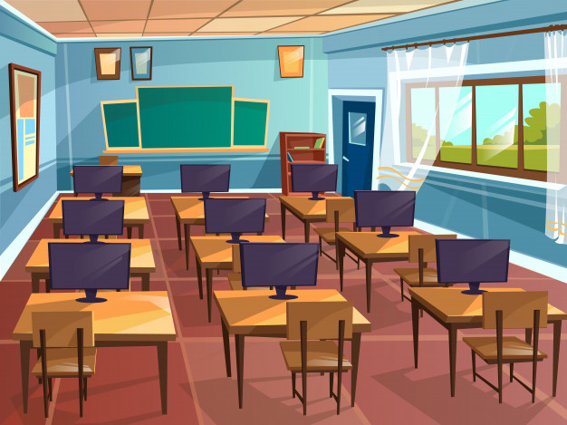
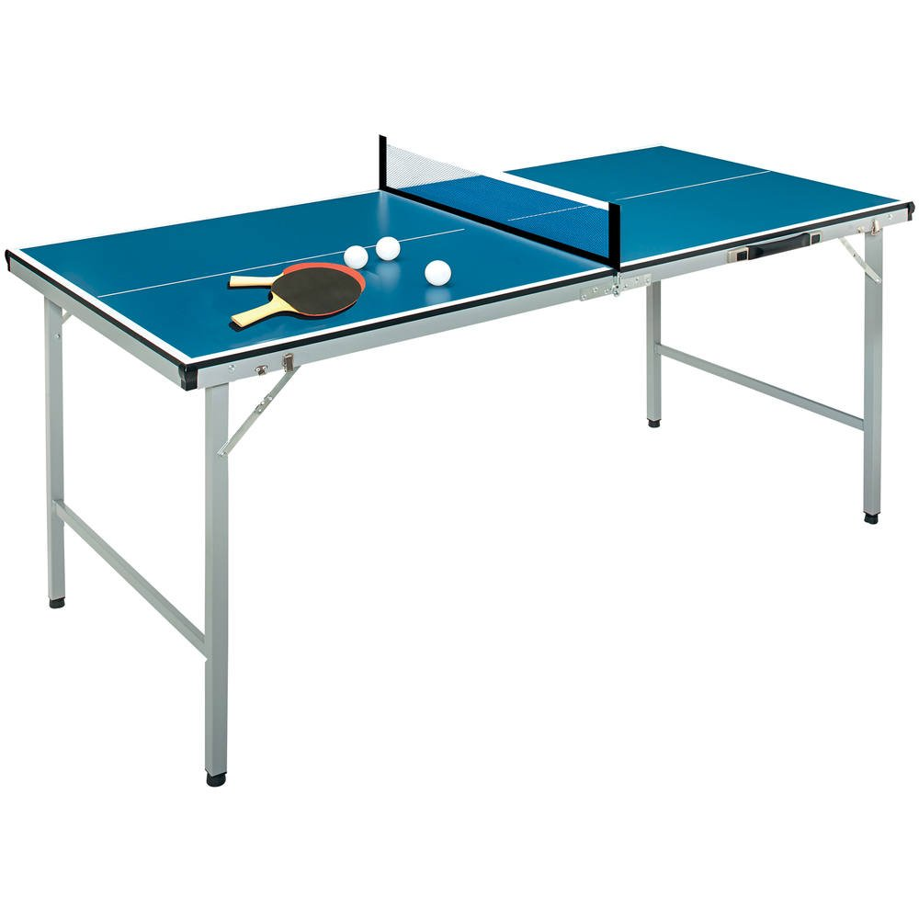
In my school, there ….
www.ardoise-craie.fr

Slide 19
Put the words in the right order
school | in | there | library | my | a | is
In my school, there is a library.
there | computer room | my | in | is | a | school
In my school, there is a computer room.
are | six | there | computers | my | school | in
In my school, there are six computers.
are | school | three | in | there | classrooms | my
In my school, there are three classrooms.
www.ardoise-craie.fr

Slide 20
Put the words in the right order
school | in | there | playgrounds | my | two | are
In my school, there are two playgrounds.
there | ping-pong table | my | in | is | a | school
In my school, there is a ping-pong table.
are | six | there | computers | my | school | in | computer room | a | and
In my school, there are six computers and a computer room.
is | school | a | in | there | library | my | books | and
In my school, there is a library and books.
www.ardoise-craie.fr

